Slide 1
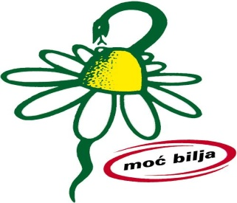
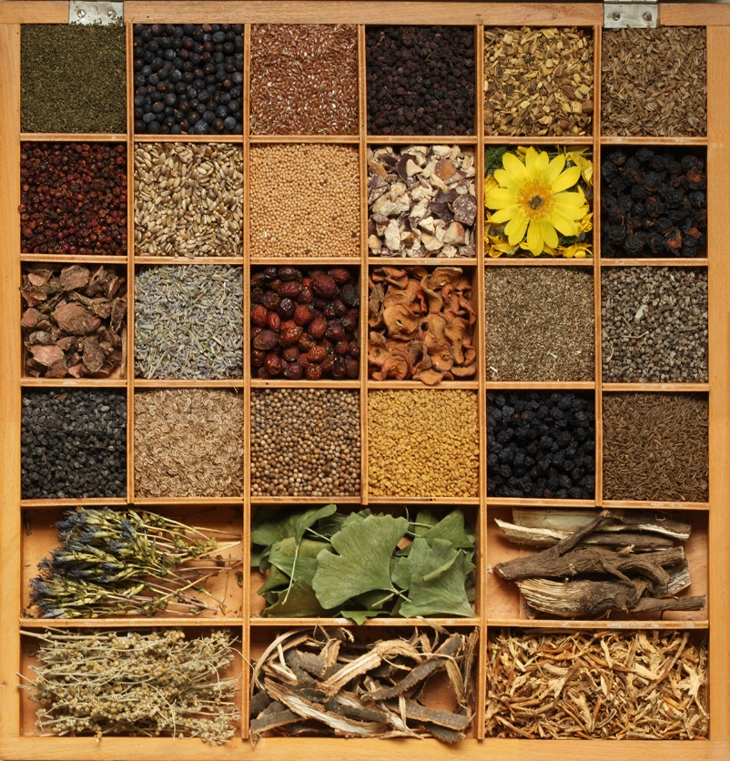
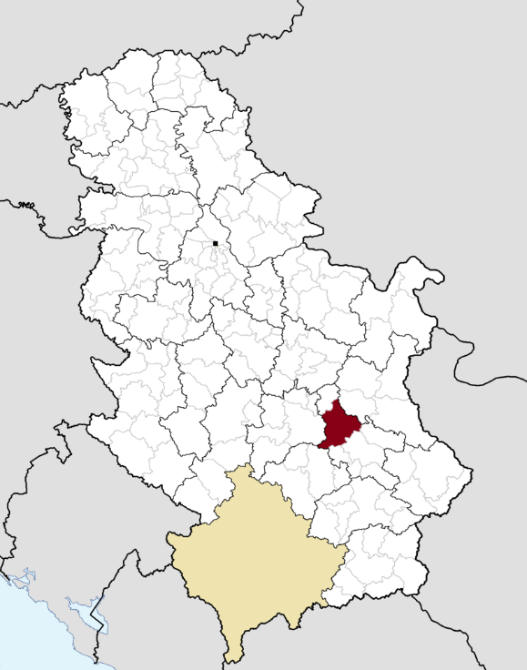
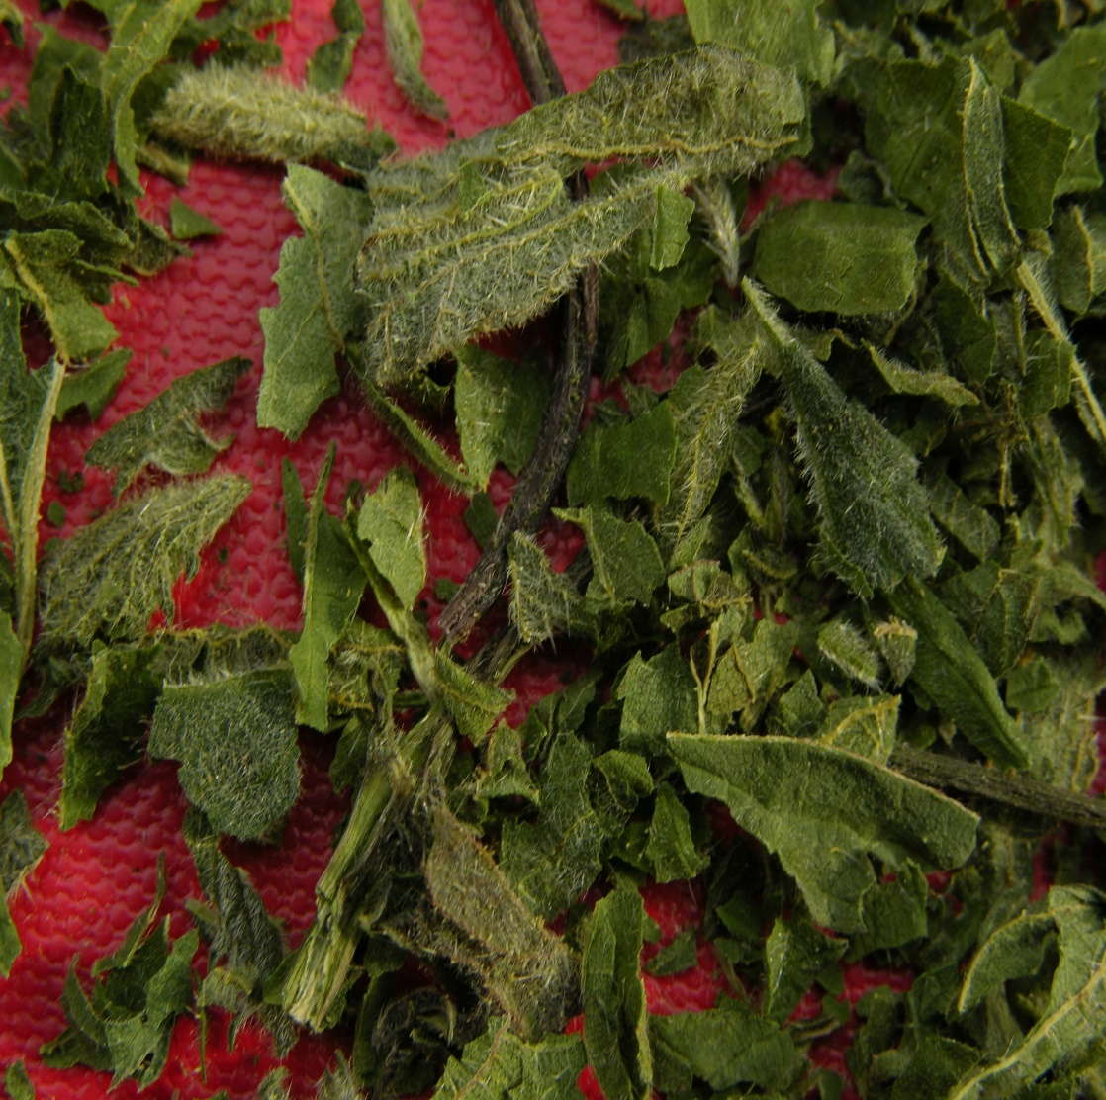
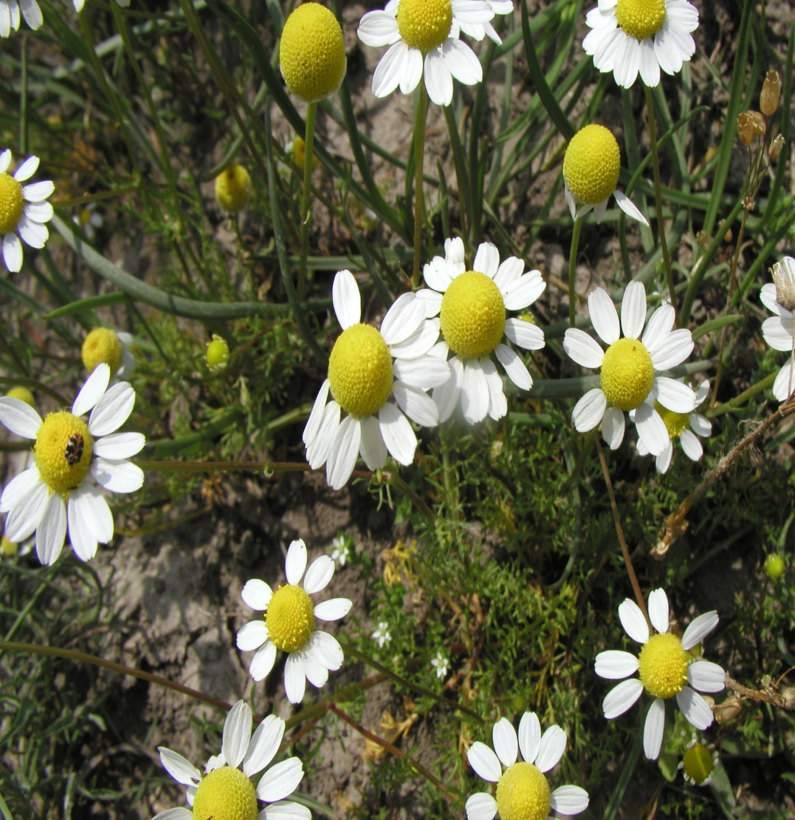
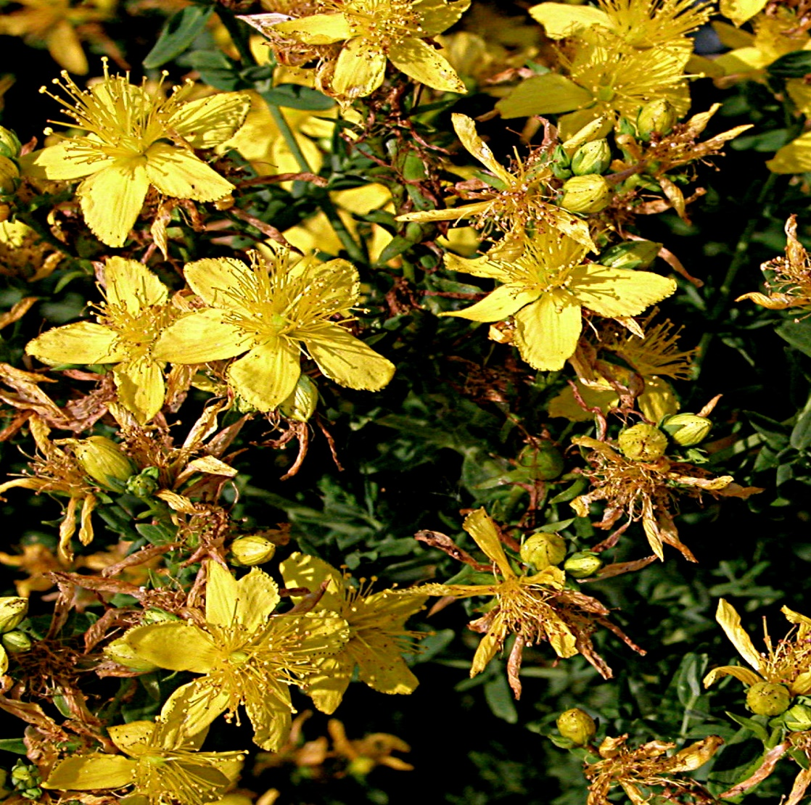
STUDY ON TRADITIONAL USE OF MEDICINAL PLANTS IN NIŠAVA DISTRICT, SOUTH-EAST SERBIA
Katarina Šavikin¹, Jelena Živković¹, Milan Ilić², Teodora Janković¹, Dejan Pljevljakušić¹, Nada Ćujić Nikolić¹, Gordana Zdunić¹
¹Institute for Medicinal Plants Research, Tadeuša Košćuška 1, Belgrade, Serbia
² Faculty of Pharmacy, Trg mladenaca 5, Novi Sad, Serbia
Introduction
Results
Ethnobotanical studies are the first step in collecting data on the traditional use of medicinal plants, which allows further steps in developing of new drugs or functional food. Since medieval times, medicinal plants have been used for the treatment of numerous health problems in Serbia.
The informants provided data for 172 medicinal plants belonging to 69 families. Lamiaceae, Asteraceae and Rosaceae were the predominantly used families in the Nišava district. The highest use value was recorded for the following species: Mentha piperita (116), Matricaria chamomilla (111) and Hypericum perforatum (102).
Aim
Our study was conducted in the area of Nišava districts which is located in the South-East part of the Republic of Serbia. It is covering an area of 7.292 square kilometers being the second district in the Republic of Serbia by surface. Considering diversity of landscapes and natural resources, poorly developed infrastructure in rural areas and depopulation of rural regions, we found Nišava district interesting for our study.
Map of the region
Figures: Mentha piperita, Matricaria chamomilla, Hypericum perforatum
Methodology
Semi-structured ethnobotanical interviews were conducted during 2018. A total of 168 informants were interviewed, 94 female and 74 males. All informants were of Serbian nationality (100%). The informants were between 16 and 83 years old (7 < 20 years; 53 from 21-40 years; 70 from 41-60 years; 36 from 61-80 years and 2 > 80 years).
The most used plant families
Gender | Male | Female
Number of informants | 74 | 94
(%) | 44,1% | 55,9%
Conclusion
The most frequently reported medicinal uses were noticed for gastrointestinal ailments, respiratory problems and skin diseases. The application was primarily oral, followed by topical applications. Aerial parts were the most exploited, but the use of all other plant parts was recorded. According to our results, traditional medicine in the Nišava district is mainly applied in primary health care for healing minor illnesses or as an addition as food.
.
Tabele: Informants by gender
Acknowledgements
This work was supported by the Ministry of Education, Science and Technological Development of the Republic of Serbia (Contract No. 451-03-9/2021-14/200003).
UNIFood Conference September 24th-25th 2021 University of Belgrade

